Slide 1






Object Oriented Analysis & Design
Engr. Abdul-Rahman Mahmood
DPM, MCP, QMR(ISO9001:2000)
armahmood786@yahoo.com alphapeeler.sf.net/pubkeys/pkey.htm pk.linkedin.com/in/armahmood www.twitter.com/alphapeeler www.facebook.com/alphapeeler
alphasecure@gmail.com http://alphapeeler.sourceforge.net http://alphapeeler.tumblr.com armahmood786@jabber.org alphapeeler@aim.com
abdulmahmood-sss alphasecure armahmood786@hotmail.com
http://alphapeeler.sf.net/me
mahmood_cubix 48660186 alphapeeler@icloud.com
http://alphapeeler.sf.net/acms/

Slide 3

Façade Design Pattern
Facade pattern hides the complexities of the system and provides an interface to the client using which the client can access the system.
This type of design pattern comes under structural pattern as this pattern adds an interface to existing system to hide its complexities.
This pattern involves a single class which provides simplified methods required by client and delegates calls to methods of existing system classes.

Slide 4

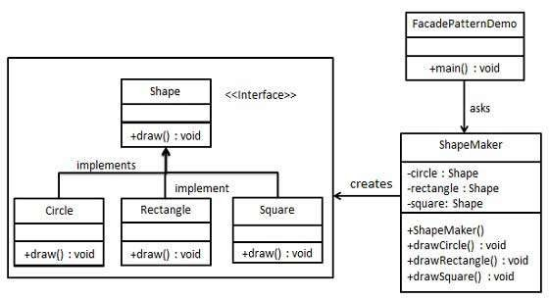
Implementation
We are going to create a Shape interface and concrete classes implementing the Shape interface. A facade class ShapeMaker is defined as a next step.
ShapeMaker class uses the concrete classes to delegate user calls to these classes. FacadePatternDemo, our demo class, will use ShapeMaker class to show the results.

Slide 5

Step 1
Create an interface.
Shape.java
public interface Shape { void draw();
}

Slide 6

Step 2
 Create concrete classes implementing same interface.
public class Rectangle implements Shape { @Override
public void draw() {
System.out.println("Rectangle::draw()"); }
}
public class Square implements Shape {
@Override
public void draw() { System.out.println(“Square ::draw()"); }
}
public class Circle implements Shape { @Override
public void draw() { System.out.println(“Circle::draw()"); }
}
Rectangle.java
Square.java
Circle.java

Slide 7
Step 3
public class ShapeMaker { private Shape circle; private Shape rectangle; private Shape square;
Create a facade class.
ShapeMaker.java
public ShapeMaker() {
circle = new Circle(); rectangle = new Rectangle(); square = new Square();
}
public void drawCircle(){ circle.draw();
}
public void drawRectangle(){ rectangle.draw();
}
public void drawSquare(){ square.draw();
}
}

Slide 8

Step 4
Use the facade to draw various types of shapes.
FacadePatternDemo.java
public class FacadePatternDemo { public static void main(String[] args) {
ShapeMaker shapeMaker = new ShapeMaker();
shapeMaker.drawCircle(); shapeMaker.drawRectangle(); shapeMaker.drawSquare();
}
}

Slide 9

Step 5
 Verify the output.
Circle::draw() Rectangle::draw() Square::draw()

